Slide 1


DECEMBER 2023
Resume Insights
INF 385T - Special Topics in Information Science: Natural Language Processing
Convo Creators : Toshita Sharma, Vimoli Mehta, Sruthi Pilla

Slide 2
Contents
Motivation
Dataset
Data Preprocessing
Methodology
Conclusion
References

Slide 3
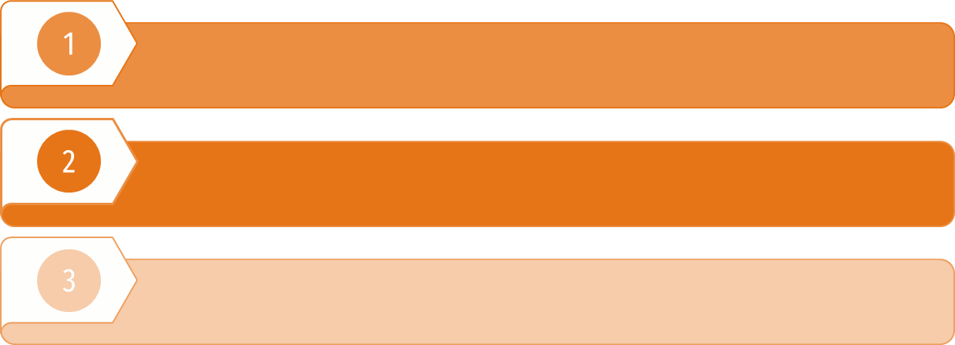
Introduction
The project aims to automate process by ranking the most suitable candidate based on a job opening description by using similarity index.
NLP techniques like TF-IDF, Word2vec, Glove vectors are used to perform feature vectorization to extract relevant information from unstructured text and wide range formats of resume.
Feature Vectorization is performed on the job description and then we have calculated the cosine similarity to show the best fitted results. We also generated TSNE plot of all clusters formed and checked model efficiency through evaluation metrics.

Slide 4

Motivation
Real Word Scenario
A method to filter resumes before handing to technical team
Automating the time consuming process of reviewing each resume
Applying NLP Techniques learnt in class
Notes:
Student Centric Approach A response to the challenges faced by students in the job market, addressing issues related to arbitrary rejections and the overwhelming volume of applications

Slide 5


Dataset
Applicants
Recruiter
2400 Resumes
24 different categories
800 Job Descriptions
along with Job title and Company name
Notes:
Contains 2400+ Resumes in string as well as PDF format.
PDF stored in the data folder differentiated into their respective labels as folders with each resume residing inside the folder in pdf form with filename as the id defined in the csv.
Inside the resume.csv :
ID: Unique identifier and file name for the respective pdf.
Resume_str : Contains the resume text only in string format.
Resume_html : Contains the resume data in html format as present while web scrapping.
Category : Category of the job the resume was used to apply.
Training_data.csv :
Contains about 800 job descriptions with job title

Slide 6
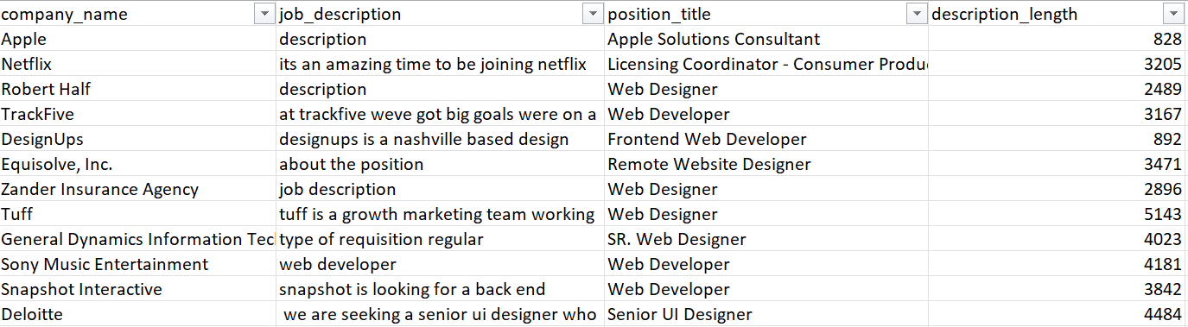
Job Description Dataset

Slide 7
Work Timeline
Data Collection -
Resume dataset
Data Analysis - Exploration
Data Preparation for Modelling
Modelling -
TfiDf, word2vec & GloVE
Comparison of models & Evaluation
1)Cosine Similarity
2)K-means clustering

Slide 8
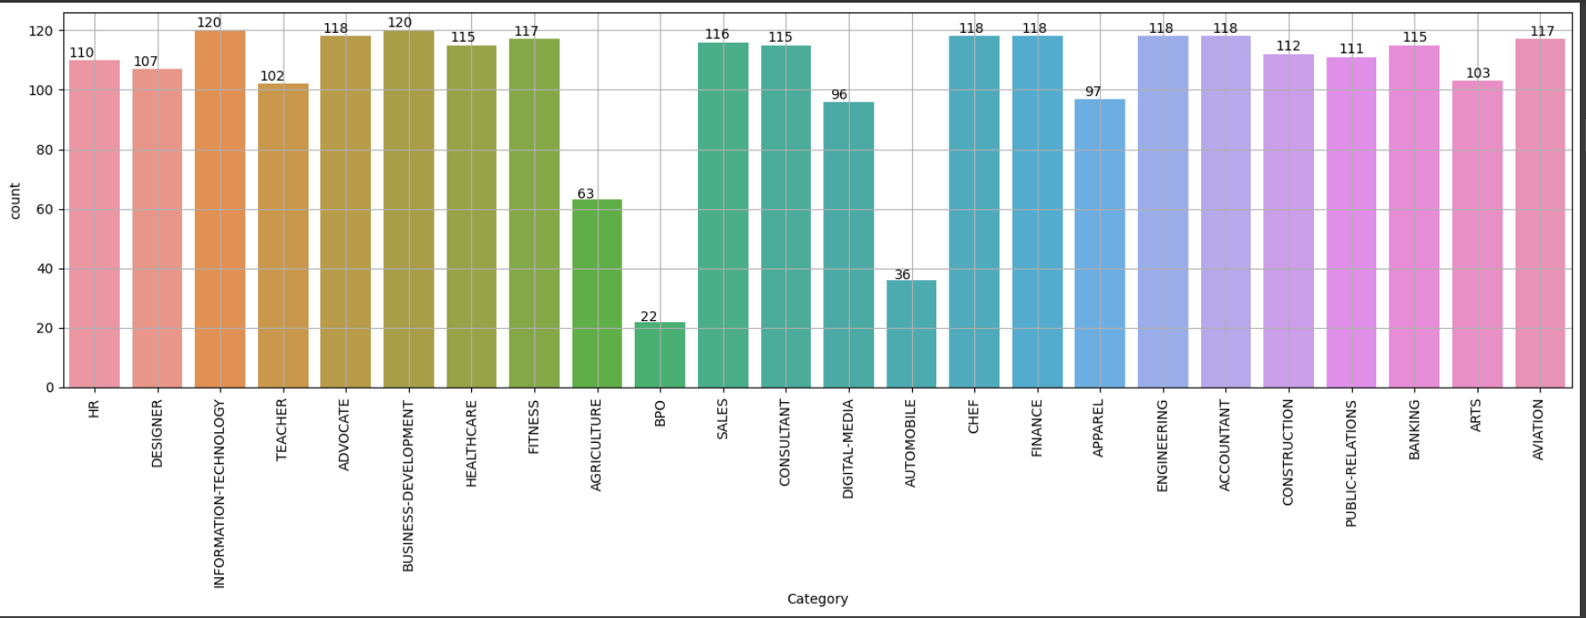
Categories Distribution

Slide 9
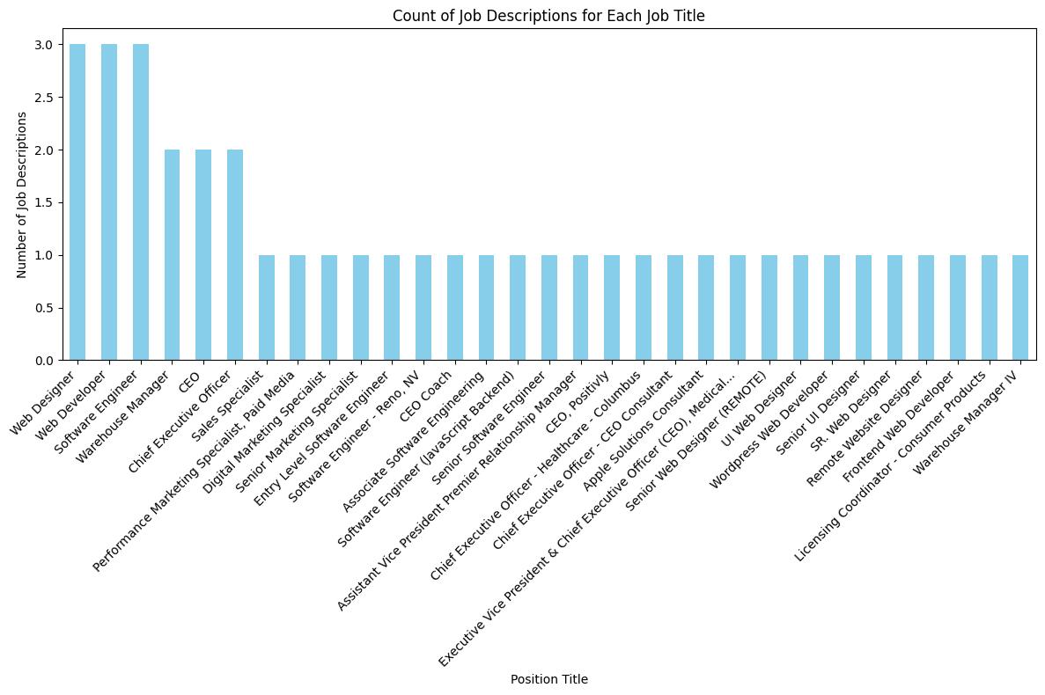

Slide 10
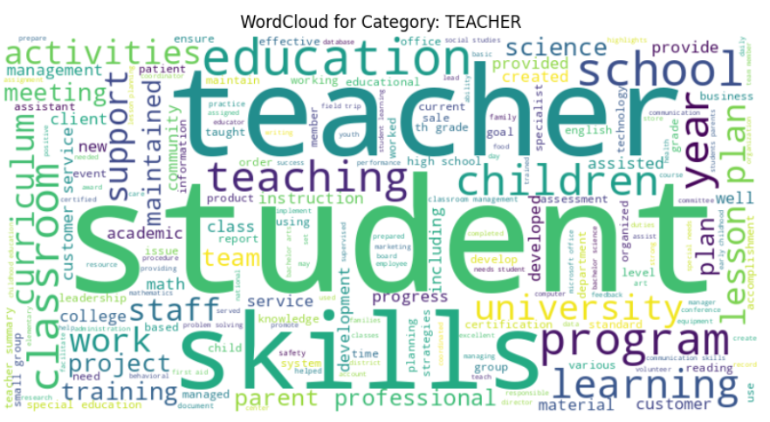


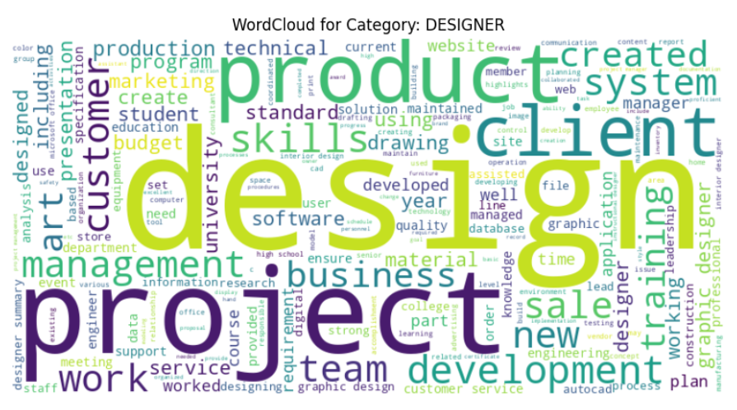
Word Cloud

Slide 11
Preprocessing
The data from each resume is extracted from PDF format using PyPDF2.
The data is converted into string format by generating a column
The feature extraction is performed following these steps:
Lowercasing the text
Removing Non-Alphabetic Characters: Eliminates any characters that are not letters.
Sentence Tokenization: Breaking the text into sentences.
Stopword Removal: Removes common English stopwords from each sentence.
Word Tokenization
POS Tagging: Tags the remaining words with their Part-of-Speech.
Filtering based on POS Tags: Retains only the words that do not have certain POS tags ('DT', 'IN', 'TO', 'PRP', 'WP').
Notes:
This function takes a row (df) from the resume data DataFrame as input. It extracts the 'ID' and 'Category' columns from the DataFrame, constructs the path to the PDF file using these values, extracts text from the PDF using extract_text_from_pdf, preprocesses the text using preprocess_text, and adds the preprocessed text as a new column ('Feature') to the DataFrame. The modified DataFrame is then returned.

Slide 12
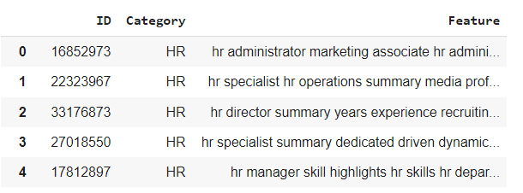
Dataset created after processing

Slide 13
Methodology
Load resume data from PDF Extraction
Load job description and process
TFIDF vectorization/ Word2Vec/ GloVe
Cosine similarity
K-means clustering with TSNE plot
Evaluation metrics
Notes:
This part loads resume data from a CSV file, applies text processing to each resume, and saves the processed data to a new CSV file.
This part loads job description data, selects relevant columns- job description and position title, and adds a new column 'Features' containing preprocessed text features.
Uses TF-IDF vectorization to convert text data into numerical vectors. We are limiting number of features 800. Fits the TF-IDF vectorizer to the job description data (job_description['Features']) and transforms it into TF-IDF vectors.
Cosine similarity compute between features of resume and job description
Applies K-means clustering to the TF-IDF vectors, assigning each resume to a cluster.
Evaluation metric

Slide 14
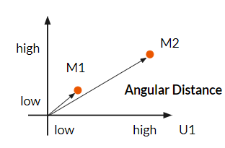
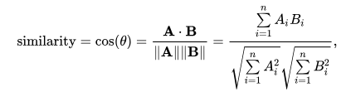
Cosine Similarity
When we have both the resume vector and the job description vector, we calculate their cosine similarity.
Cosine similarity measures the cosine of the angle between two vectors.
-1
+1
+1
Complete opposite
Perfect Match

Slide 15
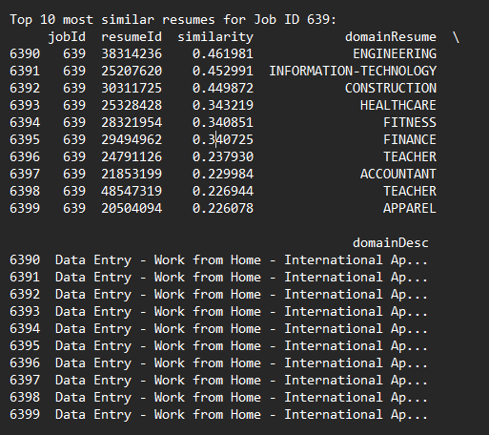
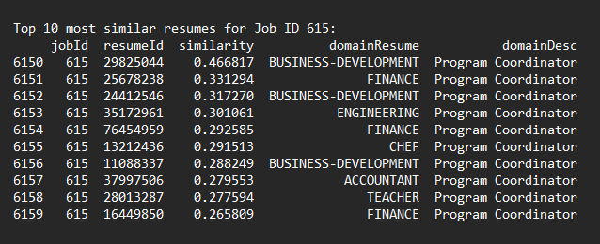
Cosine Similarity Results

Slide 16
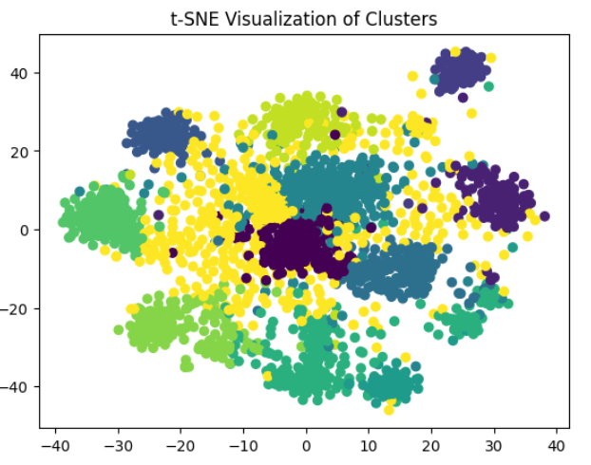
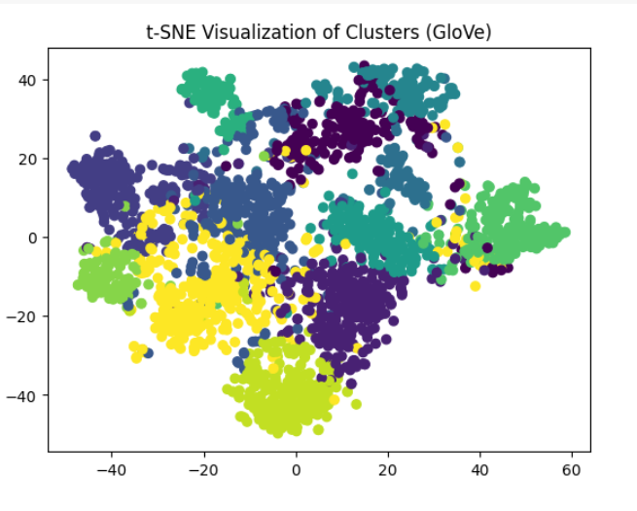
Results - TSNE plot
Notes:
This can help explore how well the data separates into clusters in the two-dimensional t-SNE space. Each point in the plot corresponds to a data point, and the colors represent the cluster assignments. Points that are close to each other in the plot are considered similar in the high-dimensional space.

Slide 17
Evaluation Metric
Silhouette score
Metric to evaluate the quality of clusters, It uses compactness of individual clusters(intra cluster distance) and separation amongst clusters (inter cluster distance) to measure an overall representative score.
susceptible to error, one must make sure the data is linearly separable
Davies bouldin Index
Evaluates the goodness of split by a K-Means clustering algorithm for a given number of clusters
estimates the average similarity between each cluster and its most comparable cluster
It considers separation between clusters and their compactness

Slide 18
Results - Metrics
Method | Silhouette score | Davies bouldin Index
TFIDF | 0.16303813635081822 | 2.824260588616969
Word2Vec | 0.33716488119485445 | 1.9519111533534133
GloVE - 100d | 0.31098058742237252 | 1.965643635247434
GloVE - 200d | 0.20460250903173687 | 2.058764127655816
GloVE - 300d | 0.21142140143016797 | 2.1013982746738864
Notes:
Best performing model is word2vec

Slide 19
Challenges Faced
Sparse Data: Resumes often have sparse information; not all candidates mention the same skills or experiences. This sparsity can affect cosine similarity, potentially downplaying similarities between candidates who might be suitable for the same category.
Handling Noise and Irrelevant Information: Resumes might contain noise or irrelevant information that can affect similarity calculations, leading to misleading clustering results and evaluation met
Scalability: Processing a large dataset of 2400+ resumes can be computationally intensive. Handling such a substantial amount of data efficiently for clustering might require optimized algorithms or computational resources.
Overlapping Clusters: The clusters might not be clearly distinct from each other. Data points could have similarities with multiple clusters, leading to overlap and ambiguity in cluster assignments.

Slide 20
Conclusion
Key Takeaways:
Word Embeddings Outperform TF-IDF:
Word2Vec method demonstrates better clustering performance compared to TF-IDF.
Impact of GloVe Embedding Dimensions:
Higher GloVe dimensions show slight improvements in clustering, yet overall performance remains subpar compared to Word2Vec.
Need for Further Enhancement:
Despite incremental improvements with different embeddings, the clustering performance requires enhancement for more distinct and well-separated clusters.
Recommendations:
Experimentation with Advanced Techniques:
Consider exploring other advanced word embedding techniques or hybrid approaches for better representation of resume data.
Hyperparameter Tuning:
Fine-tune parameters in clustering algorithms or embedding models to improve performance.
Incorporating Additional Features:
Integrate supplementary features or data preprocessing methods to enrich resume representations and enhance clustering results.

Slide 21
References
Gugnani, A., & Misra, H. (Year). Implicit Skills Extraction Using Document Embedding and Its Use in Job Recommendation. IBM Research - AI, Applied Research.
Tikhonova, M. (Year). Text Mining for Evaluation of Candidates Based on Their CVs.
Towards Data Science (https://towardsdatascience.com/): Provides various articles on text mining, NLP, and clustering techniques.
Medium (https://medium.com/): Articles related to text clustering, word embeddings, and resume analysis.
Gensim Documentation (https://radimrehurek.com/gensim/auto_examples/index.html): Information on Word2Vec and other word embedding techniques.

Slide 22


